Slide 1
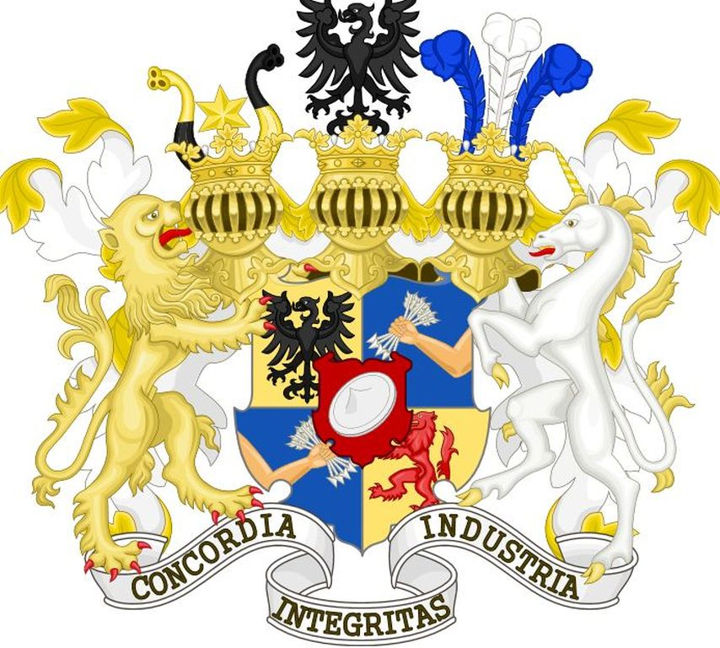
Success Story of the Rothschild Family

Slide 2
The Rothschild Family
The Rothschild’s story began with the humble beginnings of its founder, Mayer Rothschild.
With the help of Mayer Rothschild's five sons, the family business expanded throughout several European countries.
The Rothschild banking empire benefited tremendously from the French Revolution.
During the war, the Austrian army contracted Rothschild to supply it with a range of items, including wheat, uniforms, horses, and equipment.
The Rothschilds became the first bank to transcend borders.

Slide 3
Mayer Amschel Rothschild
Born in 1744, Mayer Rothschild was raised in a Jewish ghetto in Frankfurt.
Rothschild traded coins, silk and other commodities for a living.
He took an apprenticeship with a banking firm in Hanover, Germany.

Slide 4
The beginnings of a Banking Empire
After he returned, he continued the commodities and money trading business.
Rothschild was given the title “Crown Agent”.
In 1770, Rothschild married and went on to have ten children–five sons and five daughters.

Slide 5
Coat of Arms
The Rothschild coat of arms contains a clenched fist with five arrows symbolising the five dynasties established by the five sons of Mayer Rothschild.
The family motto appears below the shield: Concordia, Integritas, Industria (Unity, Integrity, Industry)

